Slide 1
ML&DL-Assisted Visualization
石大川 2022/06/01

Slide 2
Definition
Visualize ML&DL Model/Data/Task ❌
Use ML&DL to Assist Visualization Task ✔
Detailed ML&DL Algorithm/Model ❌
Visualization Task can be Assisted by ML&DL ✔

Slide 3
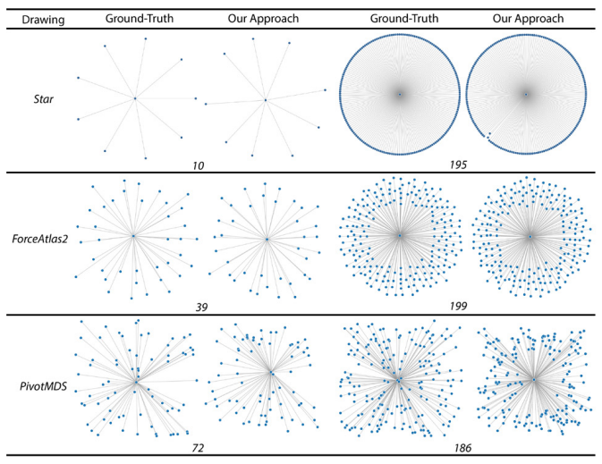
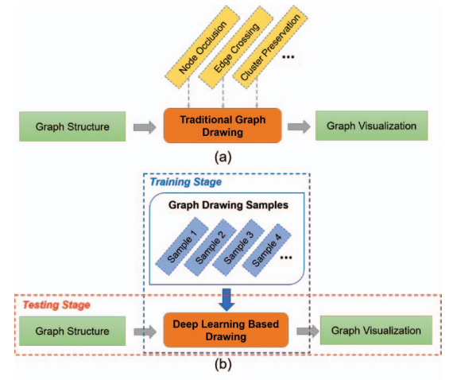
Definition
An example: Auto graph layout visualization
Y. Wang, Z. Jin, Q. Wang, W. Cui, T. Ma, and H. Qu, “Deepdrawing: A deep learning approach to graph drawing,” IEEE Transactions on Visualization and Computer Graphics, vol. 26, no. 1, pp. 676–686, 2019.

Slide 4
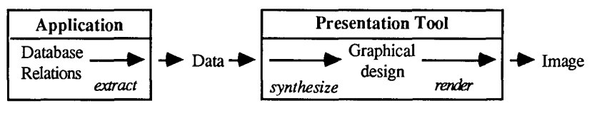
Progress
Origin
Automatically designs effective graphical presentations
J. Mackinlay, “Automating the design of graphical presentations of relational information,” Acm Transactions On Graphics (Tog), vol. 5, no. 2, pp. 110–141, 1986

Slide 5
Progress
Recent Advances
Data Processing for Visualization
Processed Data Visualization
Insight Visualization
Visualization Interaction
Q. Wang, Z. Chen, Y. Wang, and H. Qu. “A Survey on ML4VIS: Applying MachineLearning Advances to Data Visualization”, IEEE Transactions on Visualization and Computer Graphics. 2021.

Slide 6
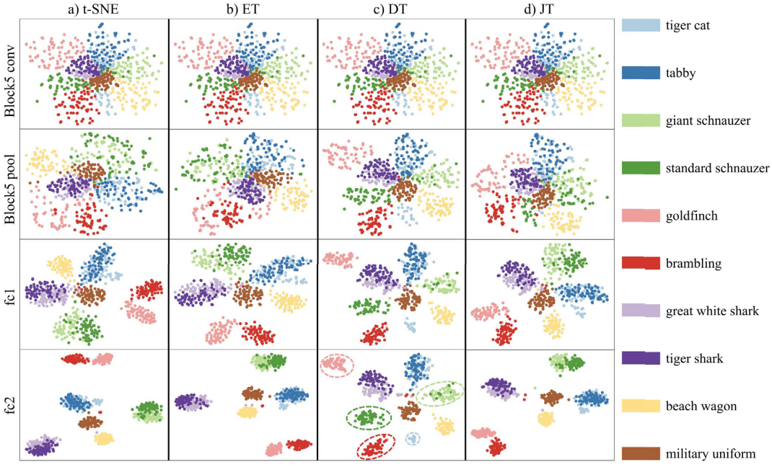
Progress
Data Processing for Visualization
Y. Wang, L. Chen, J. Jo, and Y. Wang. Joint t-sne for comparable pro-jections of multiple high-dimensional datasets. IEEE Transactions on Visualization and Computer Graphics, vol. 28, no. 1, pp. 623–632, 2021.

Slide 7
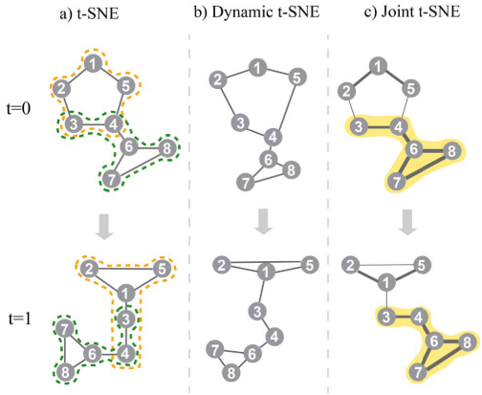
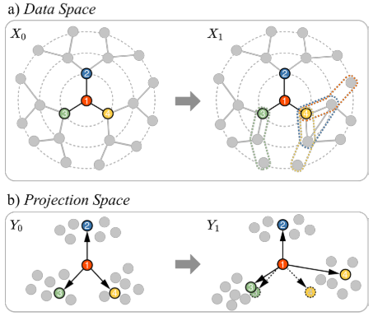
Progress
Data Processing for Visualization
Y. Wang, L. Chen, J. Jo, and Y. Wang. Joint t-sne for comparable pro-jections of multiple high-dimensional datasets. IEEE Transactions on Visualization and Computer Graphics, vol. 28, no. 1, pp. 623–632, 2021.

Slide 8
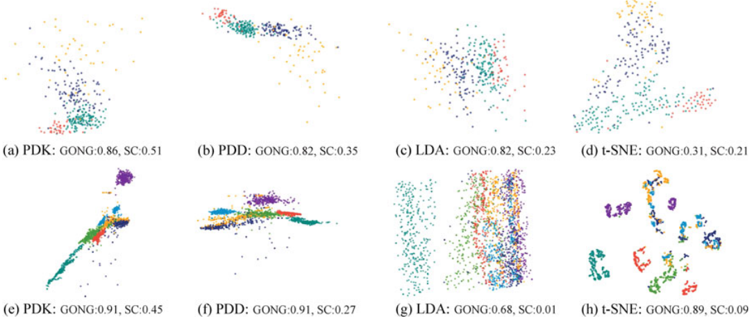
Progress
Data Processing for Visualization
Y. Wang, K. Feng, X. Chu, J. Zhang, C.-W. Fu, M. Sedlmair, X. Yu, and B. Chen, “A perception-driven approach to supervised dimensionality reduction for visualization,” IEEE Transactions on Visualization and Computer Graphics, vol. 24, no. 5, pp. 1828–1840, 2017.

Slide 9
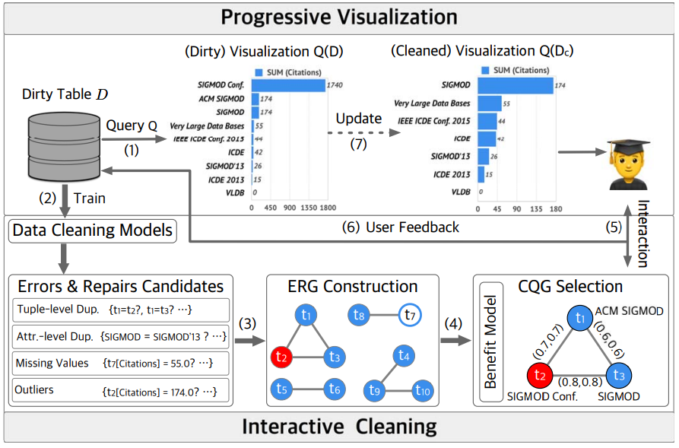
Progress
Data Processing for Visualization
Y. Luo, C. Chai, X. Qin, N. Tang, and G. Li, “Interactive cleaning for progressive visualization through composite questions,” in Proceedings of the IEEE International Conference on Data Engineering. IEEE, 2020.

Slide 10
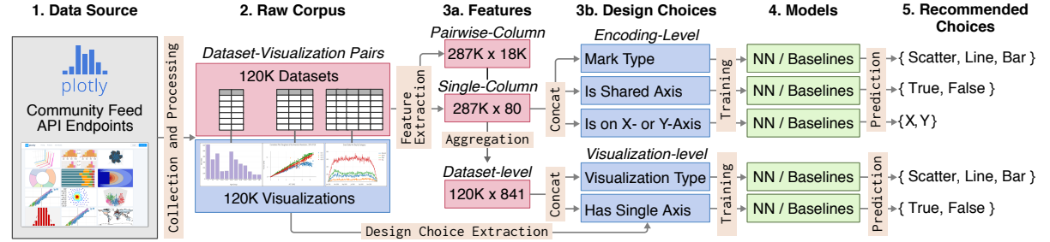
Progress
Processed Data Visualization
K. Hu, M. A. Bakker, S. Li, T. Kraska, and C. Hidalgo, “VizML: A machine learning approach to visualization recommendation,” in Proceedings of the ACM Conference on Human Factors in Computing Systems, ser. CHI ’19, 2019.

Slide 11
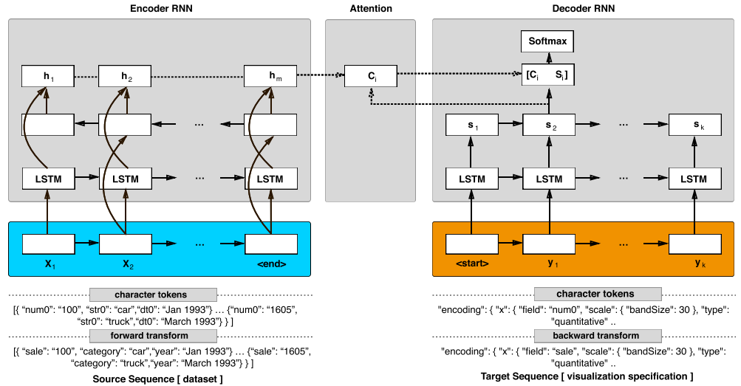
Progress
Processed Data Visualization
V. Dibia and C. Demiralp, “Data2vis: Automatic generation of data visualizations using sequence-to-sequence recurrent neural networks,” IEEE Computer Graphics and Applications, vol. 39, no. 5, pp. 33–46, 2019.

Slide 12
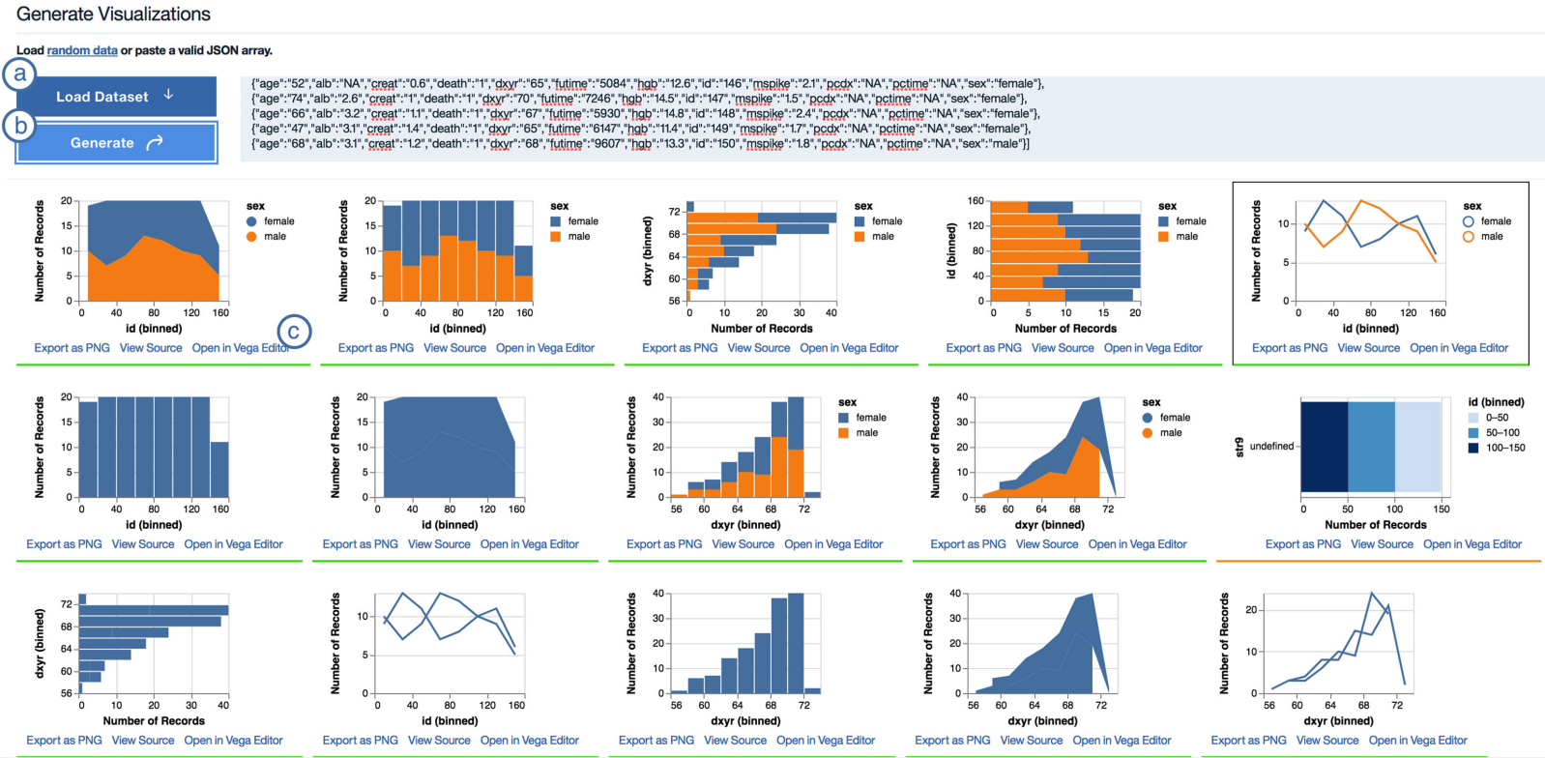
Progress
Processed Data Visualization
V. Dibia and C. Demiralp, “Data2vis: Automatic generation of data visualizations using sequence-to-sequence recurrent neural networks,” IEEE Computer Graphics and Applications, vol. 39, no. 5, pp. 33–46, 2019.

Slide 13
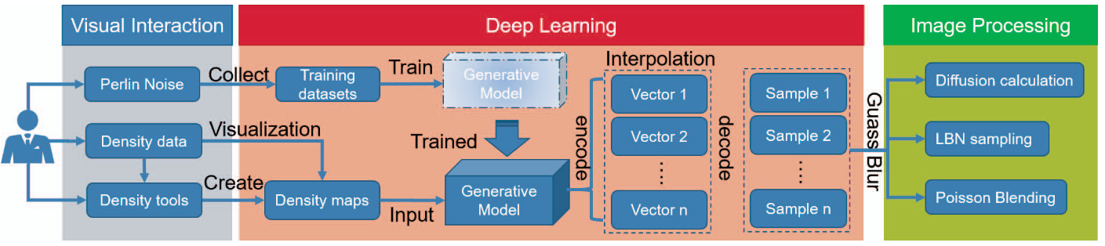
Progress
Processed Data Visualization
C. Chen, C. Wang, X. Bai, P. Zhang, and C. Li, “Generativemap: Visualization and exploration of dynamic density maps via generative learning model,” IEEE Transactions on Visualization and Computer Graphics, vol. 26, no. 1, pp. 216–226, 2019.

Slide 14
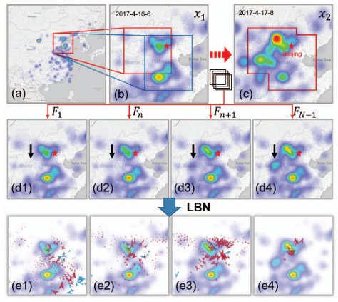
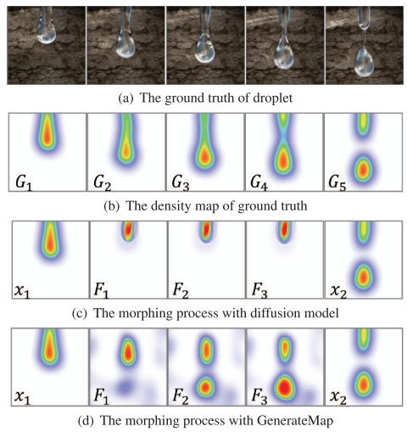
Progress
Processed Data Visualization
C. Chen, C. Wang, X. Bai, P. Zhang, and C. Li, “Generativemap: Visualization and exploration of dynamic density maps via generative learning model,” IEEE Transactions on Visualization and Computer Graphics, vol. 26, no. 1, pp. 216–226, 2019.

Slide 15
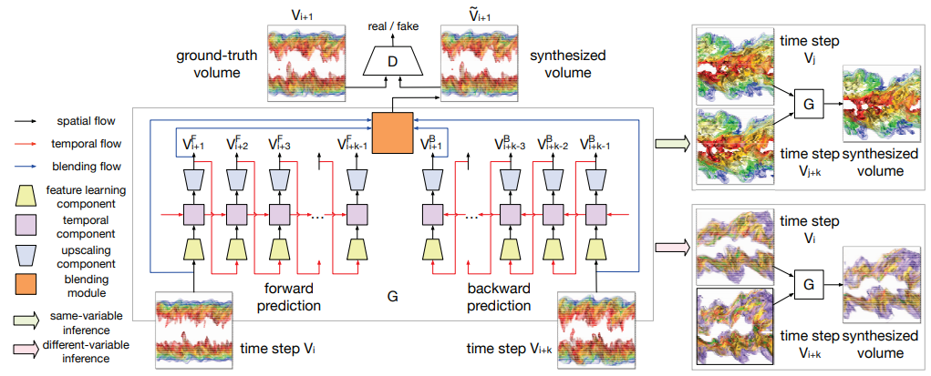
Progress
Processed Data Visualization
J. Han and C. Wang, “TSR-TVD: Temporal super-resolution for time-varying data analysis and visualization,” IEEE Transactions on Visualization and Computer Graphics, vol. 26, no. 1, pp. 205–215, 2019.

Slide 16
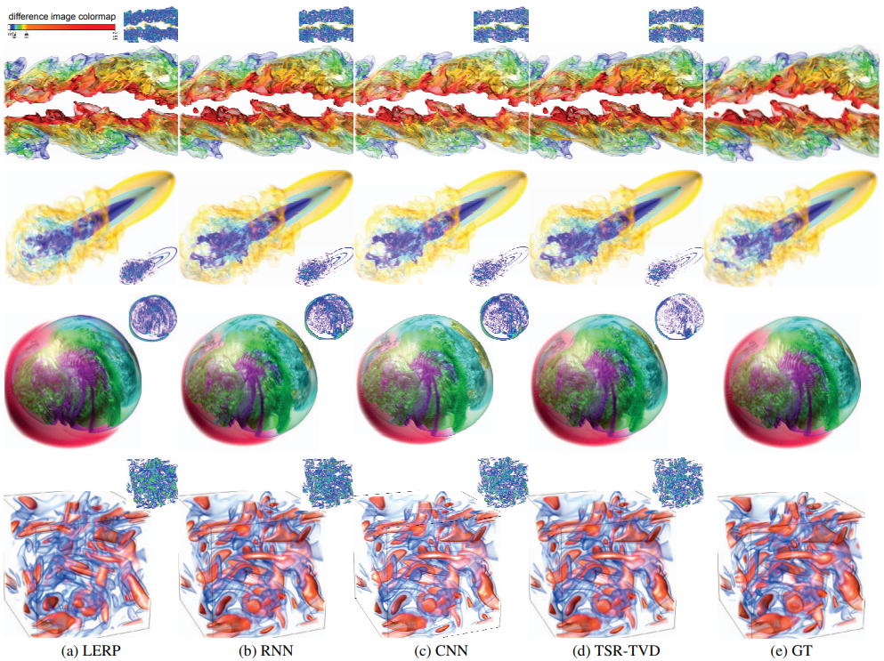
Progress
Processed Data Visualization
J. Han and C. Wang, “TSR-TVD: Temporal super-resolution for time-varying data analysis and visualization,” IEEE Transactions on Visualization and Computer Graphics, vol. 26, no. 1, pp. 205–215, 2019.

Slide 17
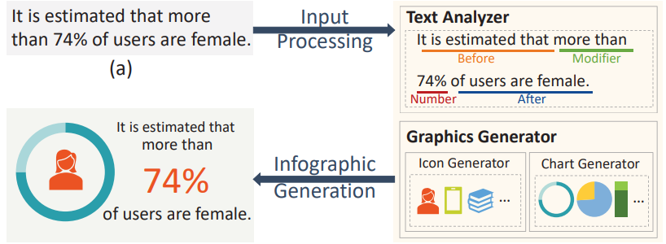
Progress
Insight Visualization
C. Qian, S. Sun, W. Cui, J.-G. Lou, H. Zhang, and D. Zhang, “Retrieve-then-adapt: Example-based automatic generation for proportionrelated infographics,” IEEE Transactions on Visualization and Computer Graphics, 2020.

Slide 18
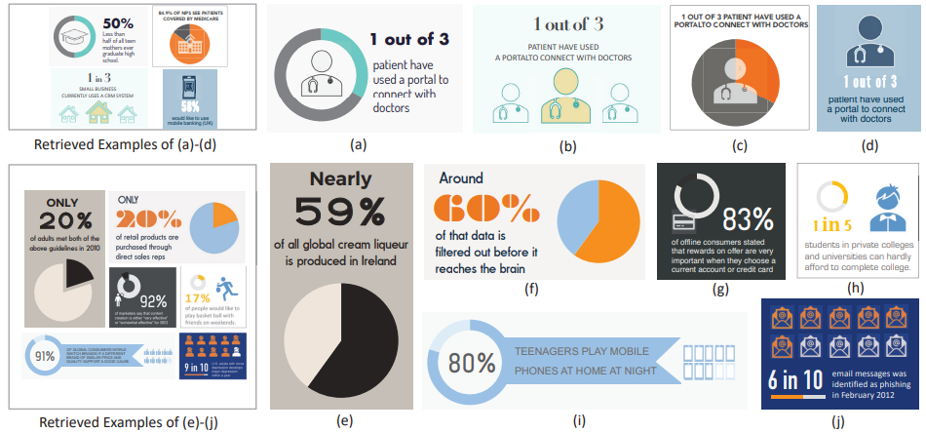
Progress
Insight Visualization
C. Qian, S. Sun, W. Cui, J.-G. Lou, H. Zhang, and D. Zhang, “Retrieve-then-adapt: Example-based automatic generation for proportionrelated infographics,” IEEE Transactions on Visualization and Computer Graphics, 2020.

Slide 19
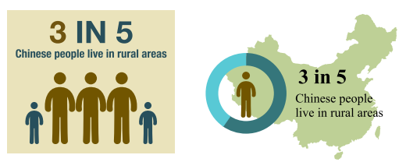
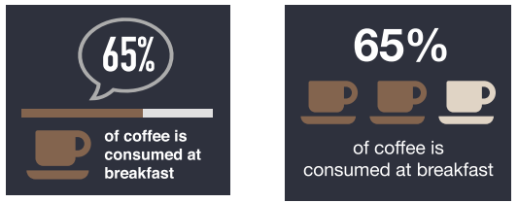
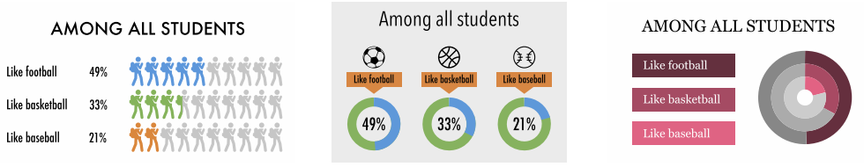
Progress
Insight Visualization
W. Cui, X. Zhang, Y. Wang, H. Huang, B. Chen, L. Fang, H. Zhang, J.-G. Lou, and D. Zhang, “Text-to-Viz: Automatic generation of infographics from proportion-related natural language statements,” IEEE Transactions on Visualization and Computer graphics, vol. 26, no. 1, pp. 906–916, 2019.

Slide 20
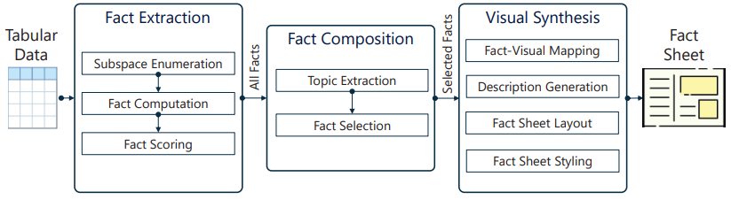
Progress
Insight Visualization
Y. Wang, Z. Sun, H. Zhang, W. Cui, K. Xu, X. Ma, and D. Zhang, “Datashot: Automatic generation of fact sheets from tabular data,” IEEE Transactions on Visualization and Computer Graphics, vol. 26, no. 1, pp. 895–905, 2019.

Slide 21
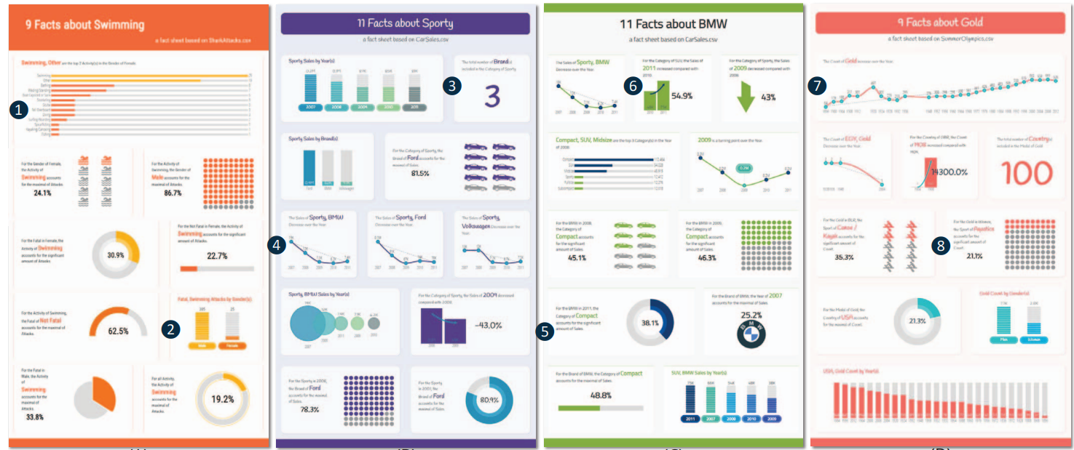
Progress
Insight Visualization
Y. Wang, Z. Sun, H. Zhang, W. Cui, K. Xu, X. Ma, and D. Zhang, “Datashot: Automatic generation of fact sheets from tabular data,” IEEE Transactions on Visualization and Computer Graphics, vol. 26, no. 1, pp. 895–905, 2019.

Slide 22
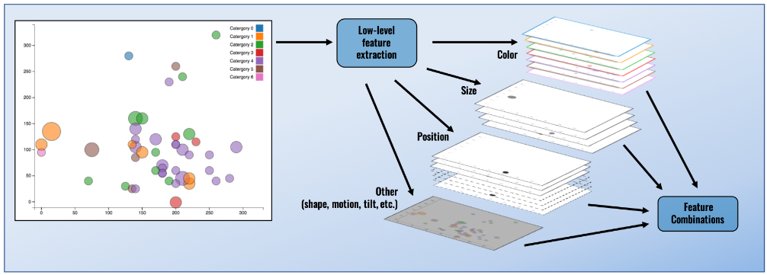
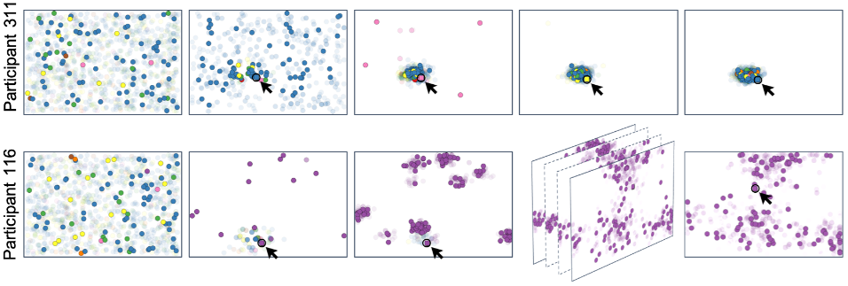
Progress
Visualization Interaction
A. Ottley, R. Garnett, and R. Wan, “Follow the clicks: Learning and anticipating mouse interactions during exploratory data analysis,” Computer Graphics Forum, vol. 38, no. 3, pp. 41–52, 2019.

Slide 23
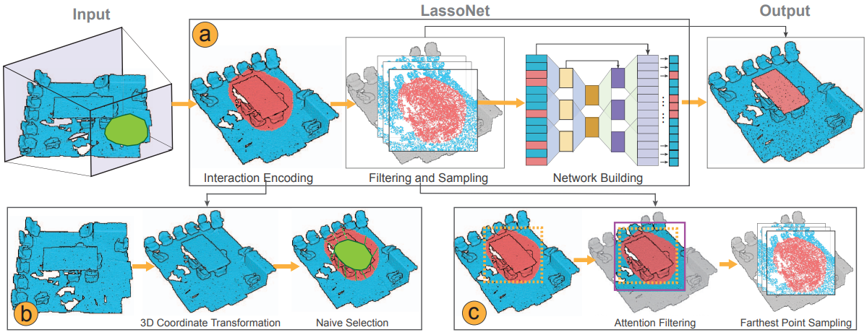
Progress
Visualization Interaction
Z. Chen, W. Zeng, Z. Yang, L. Yu, C.-W. Fu, and H. Qu, “LassoNet: Deep lasso-selection of 3d point clouds,” IEEE Transactions on Visualization and Computer Graphics, vol. 26, no. 1, pp. 195–204, 2019.

Slide 24
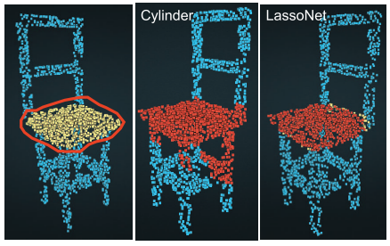
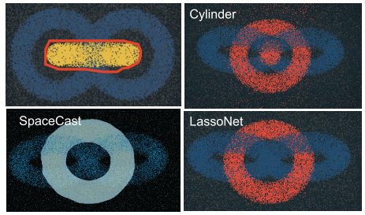
Progress
Visualization Interaction
Z. Chen, W. Zeng, Z. Yang, L. Yu, C.-W. Fu, and H. Qu, “LassoNet: Deep lasso-selection of 3d point clouds,” IEEE Transactions on Visualization and Computer Graphics, vol. 26, no. 1, pp. 195–204, 2019.

Slide 25
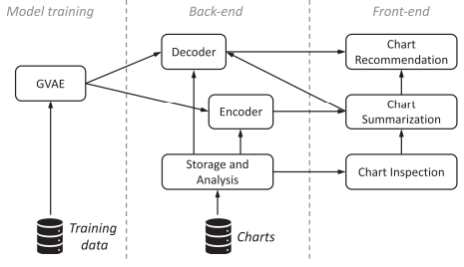
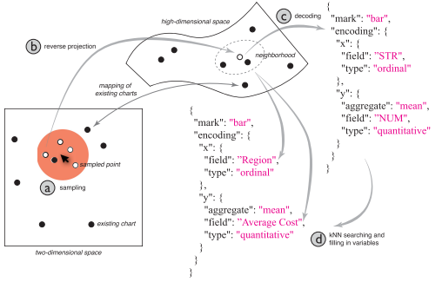
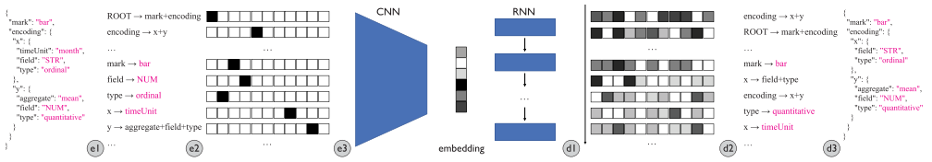
Progress
Visualization Interaction
J. Zhao, M. Fan, and M. Feng, “Chartseer: Interactive steering exploratory visual analysis with machine intelligence,” IEEE Transactions on Visualization and Computer Graphics, 2020

Slide 26
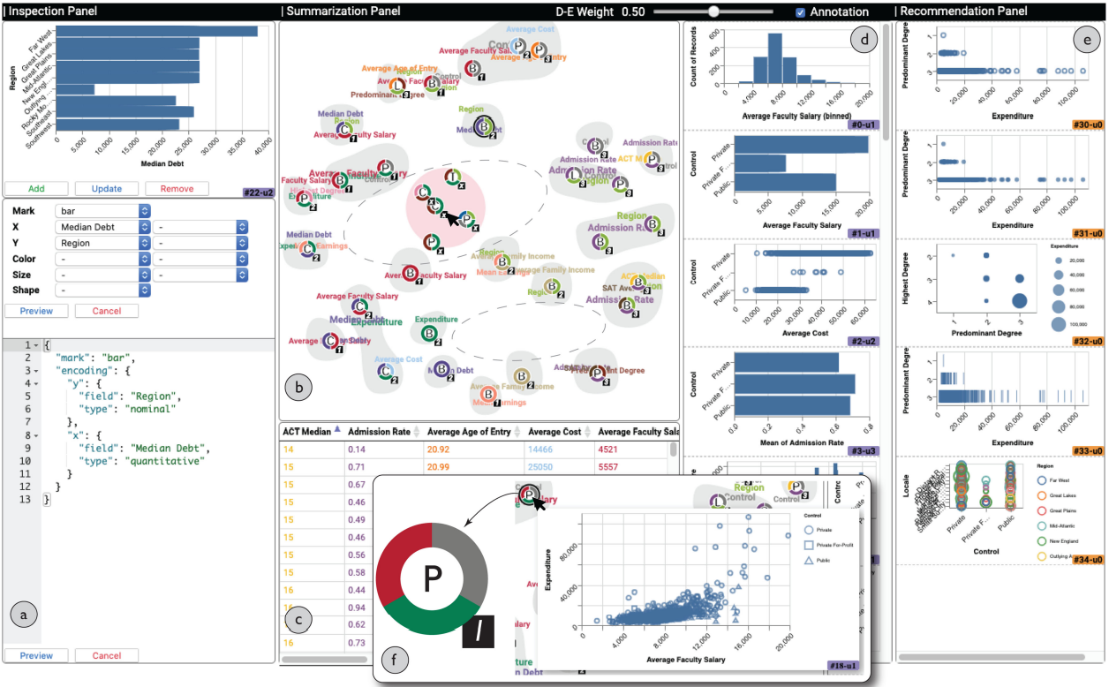
Progress
Visualization Interaction
J. Zhao, M. Fan, and M. Feng, “Chartseer: Interactive steering exploratory visual analysis with machine intelligence,” IEEE Transactions on Visualization and Computer Graphics, 2020

Slide 27
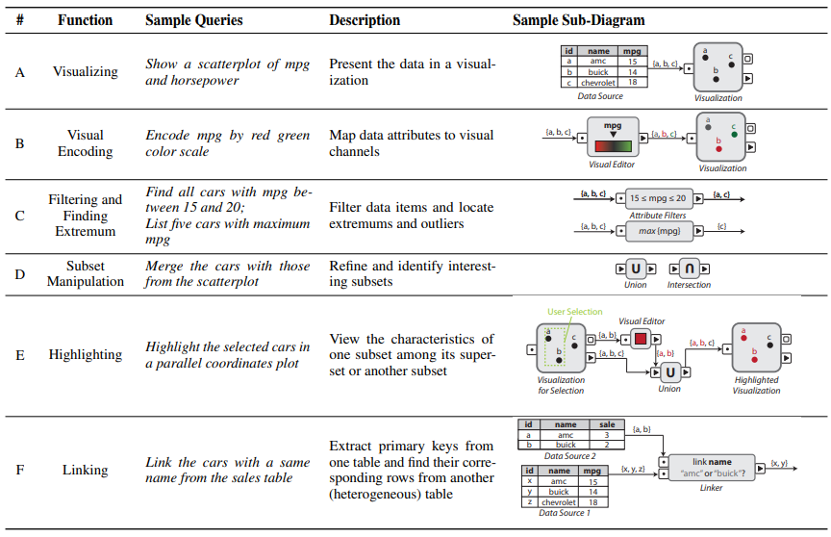
Progress
Visualization Interaction
B. Yu and C. T. Silva, “Flowsense: A natural language interface for visual data exploration within a dataflow system,” IEEE Transactions on Visualization and Computer Graphics, vol. 26, no. 1, pp. 1–11, 2019.

Slide 28
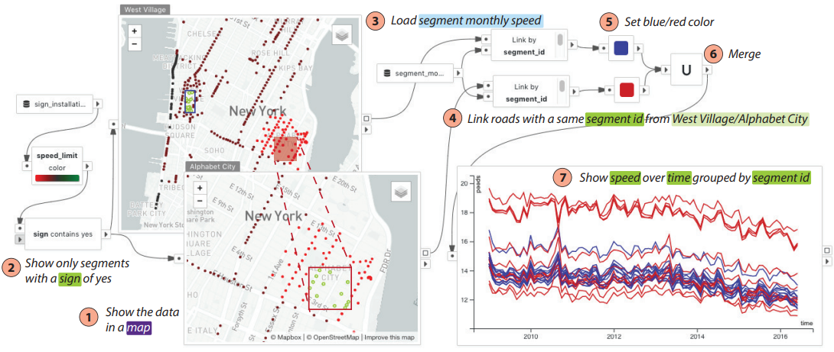
Progress
Visualization Interaction
B. Yu and C. T. Silva, “Flowsense: A natural language interface for visual data exploration within a dataflow system,” IEEE Transactions on Visualization and Computer Graphics, vol. 26, no. 1, pp. 1–11, 2019.

Slide 29
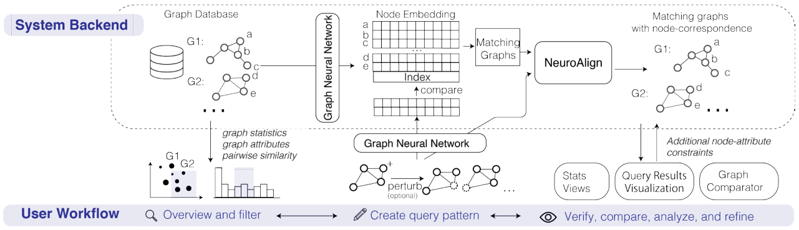
Progress
Visualization Interaction
H. Song, Z. Dai, P. Xu, and L. Ren. Interactive visual pattern search on graph data via graph representation learning. IEEE Transactions on Visualization and Computer Graphics, vol. , no. 1, pp. 335–345, 2021.

Slide 30
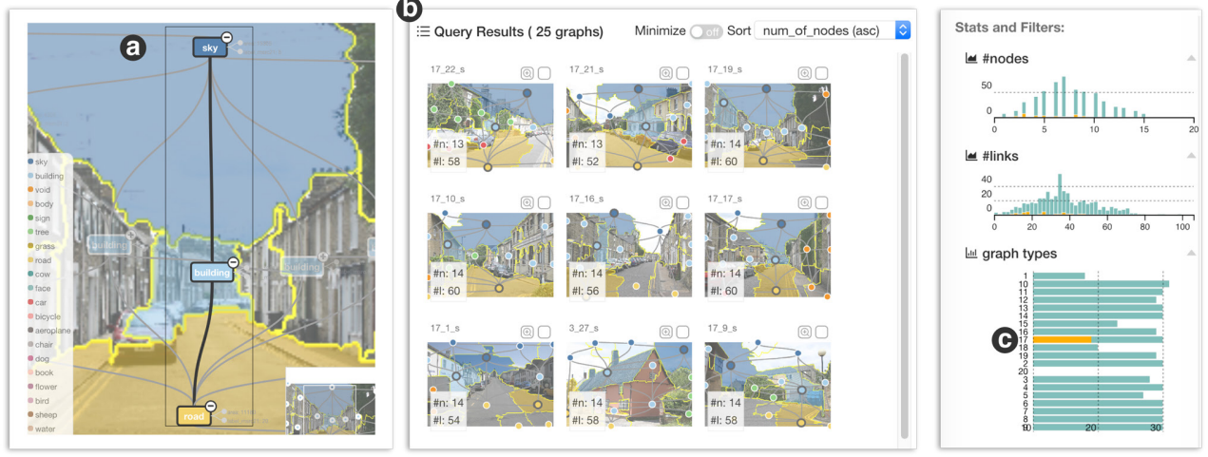
Progress
Visualization Interaction
H. Song, Z. Dai, P. Xu, and L. Ren. Interactive visual pattern search on graph data via graph representation learning. IEEE Transactions on Visualization and Computer Graphics, vol. , no. 1, pp. 335–345, 2021.

Slide 31
Challenges
Lack of Public High-Quality Datasets
Size of data
Reliability of label
Select Proper ML&DL algorithms
Inherent drawbacks of ML&DL
Adaptation for specific tasks
ML/DL-Assisted Dynamic Visualization
Animation
Video

Slide 32
Insights
Develop Dedicated ML&DL for Visualization
General ML&DL for natural images
Dedicated ML&DL for charts, diagrams, graphs and so on
Balance Automation and Human Involvement
Traditional manually designed visualization
Novel automatic visualization
Large-scale Pretrained ML&DL Model for Various Visualization Tasks
More generic model
Easier to finetuning on various downstreaming visualization tasks.

Slide 33
References
[1] A. Ottley, R. Garnett, and R. Wan, “Follow the clicks: Learning and anticipating mouse interactions during exploratory data analysis,” Computer Graphics Forum, vol. 38, no. 3, pp. 41–52, 2019.
[2] B. Yu and C. T. Silva, “Flowsense: A natural language interface for visual data exploration within a dataflow system,” IEEE Transactions on Visualization and Computer Graphics, vol. 26, no. 1, pp. 1–11, 2019
[3] C. C. Gramazio, J. Huang, and D. H. Laidlaw, “An analysis of automated visual analysis classification: Interactive visualization task inference of cancer genomics domain experts,” IEEE Transactions on Visualization and Computer Graphics, vol. 24, no. 8, pp. 2270–2283, 2017.
[4] C. Chen, C. Wang, X. Bai, P. Zhang, and C. Li, “Generativemap: Visualization and exploration of dynamic density maps via generative learning model,” IEEE Transactions on Visualization and Computer Graphics, vol. 26, no. 1, pp. 216–226, 2019.
[5] C. Qian, S. Sun, W. Cui, J.-G. Lou, H. Zhang, and D. Zhang, “Retrieve-then-adapt: Example-based automatic generation for proportionrelated infographics,” IEEE Transactions on Visualization and Computer Graphics, 2020.
[6] E. Dimara and C. Perin, “What is interaction for data visualization?” IEEE Transactions on Visualization and Computer Graphics, vol. 26, no. 1, pp. 119–129, 2020.
[7] J. Han and C. Wang, “TSR-TVD: Temporal super-resolution for time-varying data analysis and visualization,” IEEE Transactions on Visualization and Computer Graphics, vol. 26, no. 1, pp. 205–215, 2019.
[8] J. Mackinlay, “Automating the design of graphical presentations of relational information,” Acm Transactions On Graphics (Tog), vol. 5, no. 2, pp. 110–141, 1986.
[9] J. Zhao, M. Fan, and M. Feng, “Chartseer: Interactive steering exploratory visual analysis with machine intelligence,” IEEE Transactions on Visualization and Computer Graphics, 2020 .
[10] H. Song, Z. Dai, P. Xu, and L. Ren. Interactive visual pattern search on graph data via graph representation learning. IEEE Transactions on Visualization and Computer Graphics, vol. , no. 1, pp. 335–345, 2021.

Slide 34
References
[11] K. Hu, M. A. Bakker, S. Li, T. Kraska, and C. Hidalgo, “VizML: A machine learning approach to visualization recommendation,” in Proceedings of the ACM Conference on Human Factors in Computing Systems, ser. CHI ’19, 2019.
[12] M. Berger, J. Li, and J. A. Levine, “A generative model for volume rendering,” IEEE Transactions on Visualization and Computer Graphics, vol. 25, no. 4, pp. 1636–1650, 2019.
[13] O. Kwon and K. Ma, “A deep generative model for graph layout,” IEEE Transactions on Visualization and Computer Graphics, vol. 26, no. 1, pp. 665–675, Jan 2020.
[14] O. Kwon, T. Crnovrsanin, and K. Ma, “What would a graph look like in this layout? a machine learning approach to large graph visualization,” IEEE Transactions on Visualization and Computer Graphics, vol. 24, no. 1, pp. 478–488, Jan 2018.
[15] P. Zhang, C. Li, and C. Wang, “Viscode: Embedding information in visualization images using encoder-decoder network,” IEEE Transactions on Visualization and Computer Graphics, 2020.
[16] Q. Wang, Z. Chen, Y. Wang, and H. Qu. “A Survey on ML4VIS: Applying MachineLearning Advances to Data Visualization”, IEEE Transactions on Visualization and Computer Graphics. 2021.
[17] S. Smart, K. Wu, and D. A. Szafir, “Color crafting: Automating the construction of designer quality color ramps,” IEEE Transactions on Visualization and Computer Graphics, vol. 26, no. 1, pp. 1215–1225, Jan 2020.
[18] T. Tang, R. Li, X. Wu, S. Liu, J. Knittel, S. Koch, T. Ertl, L. Yu, P. Ren, and Y. Wu, “PlotThread: Creating expressive storyline visualizations using reinforcement learning,” IEEE Transactions on Visualization and Computer Graphics, 2020.
[19] V. Dibia and C. Demiralp, “Data2vis: Automatic generation of data visualizations using sequence-to-sequence recurrent neural networks,” IEEE Computer Graphics and Applications, vol. 39, no. 5, pp. 33–46, 2019.
[20] W. Cui, X. Zhang, Y. Wang, H. Huang, B. Chen, L. Fang, H. Zhang, J.-G. Lou, and D. Zhang, “Text-to-Viz: Automatic generation of infographics from proportion-related natural language statements,” IEEE Transactions on Visualization and Computer graphics, vol. 26, no. 1, pp. 906–916, 2019.

Slide 35
References
[21] W. He, J. Wang, H. Guo, K.-C. Wang, H.-W. Shen, M. Raj, Y. S. Nashed, and T. Peterka, “InSituNet: Deep image synthesis for parameter space exploration of ensemble simulations,” IEEE Transactions on Visualization and Computer Graphics, vol. 26, no. 1, pp. 23–33, 2019.
[22] Y. Luo, C. Chai, X. Qin, N. Tang, and G. Li, “Interactive cleaning for progressive visualization through composite questions,” in Proceedings of the IEEE International Conference on Data Engineering. IEEE, 2020.
[23] Y. Luo, X. Qin, N. Tang, and G. Li, “Deepeye: towards automatic data visualization,” in Proceedings of the IEEE International Conference on Data Engineering. IEEE, 2018, pp. 101–112.
[24] Y. Ma, A. K. Tung, W. Wang, X. Gao, Z. Pan, and W. Chen, “ScatterNet: A deep subjective similarity model for visual analysis of scatterplots,” IEEE Transactions on Visualization and Computer Graphics, 2018.
[25] Y. Wang, K. Feng, X. Chu, J. Zhang, C.-W. Fu, M. Sedlmair, X. Yu, and B. Chen, “A perception-driven approach to supervised dimensionality reduction for visualization,” IEEE Transactions on Visualization and Computer Graphics, 2017.
[26] Y. Wang, L. Chen, J. Jo, and Y. Wang. Joint t-sne for comparable pro-jections of multiple high-dimensional datasets. IEEE Transactions on Visualization and Computer Graphics, vol. 28, no. 1, pp. 623–632, 2021.
[27] Y. Wang, Z. Jin, Q. Wang, W. Cui, T. Ma, and H. Qu, “Deepdrawing: A deep learning approach to graph drawing,” IEEE Transactions on Visualization and Computer Graphics, vol. 26, no. 1, pp. 676–686, 2019.
[28] Y. Wang, Z. Sun, H. Zhang, W. Cui, K. Xu, X. Ma, and D. Zhang, “Datashot: Automatic generation of fact sheets from tabular data,” IEEE Transactions on Visualization and Computer Graphics, vol. 26, no. 1, pp. 895–905, 2019.
[29] Z. Chen, W. Zeng, Z. Yang, L. Yu, C.-W. Fu, and H. Qu, “LassoNet: Deep lasso-selection of 3d point clouds,” IEEE Transactions on Visualization and Computer Graphics, vol. 26, no. 1, pp. 195–204, 2019.
[30] Z. Chen, Y. Wang, Q. Wang, Y. Wang, and H. Qu, “Towards automated infographic design: Deep learning-based auto-extraction of extensible timeline,” IEEE Transactions on Visualization and Computer Graphics, vol. 26, no. 1, pp. 917–926, 2019.

Slide 36
Thanks for Listening
石大川 2022/06/01

